Slide 1
Welkom
Alumni
Dr.ir. Eric van der Geer Rutten Rijswijk
Adjunct-Directeur Bedrijfsvoering
Industrial Engineering & Innovation Sciences

Slide 2
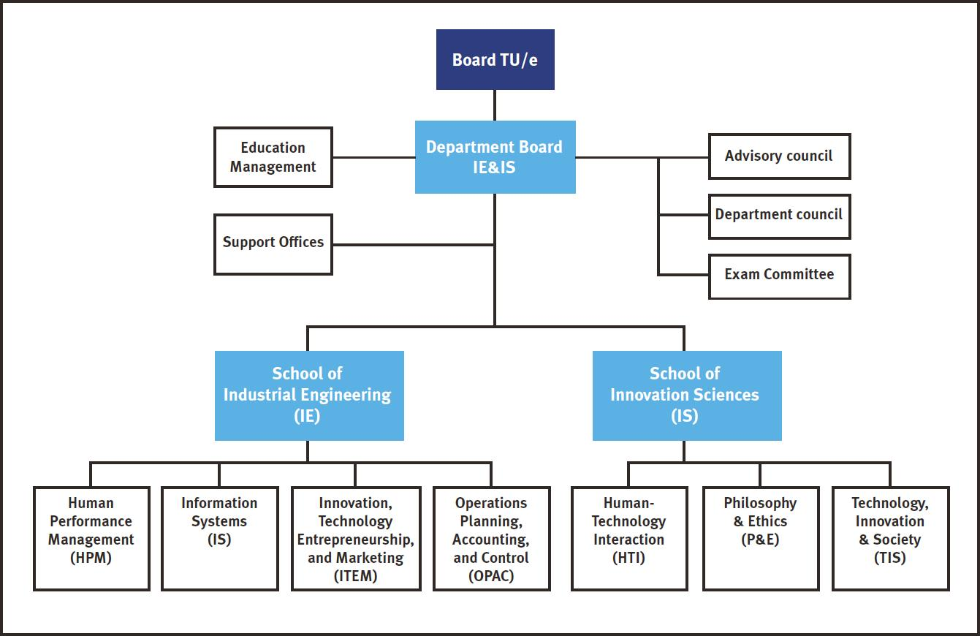
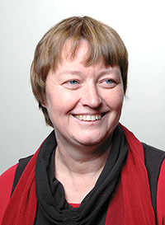
Faculteit IE&IS
Dean:
prof.dr. Ingrid Heynderickx

Slide 3
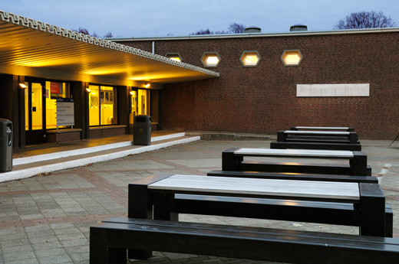
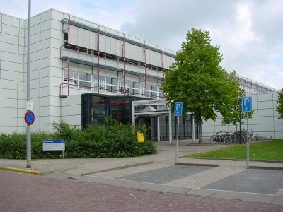
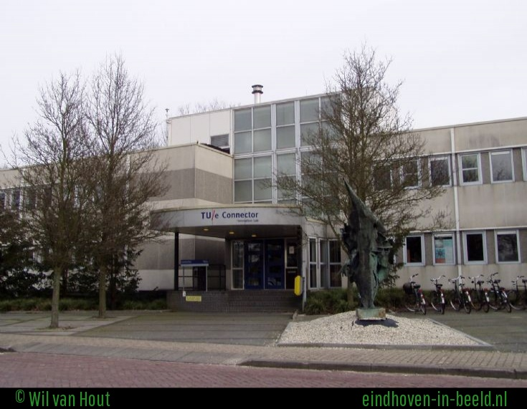
Faculteit IE&IS

Slide 4
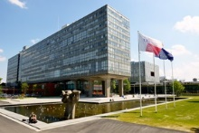
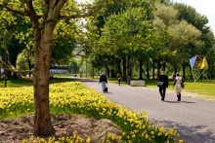
TU/e: Campus 2020
In 2006 heeft de TU/e het huisvestingsplan Campus 2020 opgesteld. Een omvangrijk vernieuwingsplan voor het realiseren van een compacte campus voor eigen gebruik van de TU/e.
Campus 2020 staat voor een campus, waarin alle faculteiten en studenten- voorzieningen geconcentreerd liggen aan een langgerekte, autovrije, groene loper. Een levendig gebied. Campus 2020 is een aantrekkelijke werk- en leeromgeving, waar wetenschappers van allerlei disciplines en studenten uit binnen- en buitenland elkaar ongedwongen kunnen ontmoeten

Slide 5
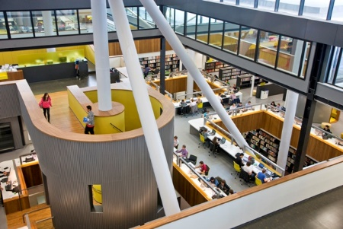
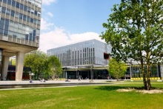
TU/e: Campus 2020
De compacte campus wordt een plek waar de grens tussen wetenschap en bedrijfsleven vervaagt door het gemeenschappelijk en flexibel gebruik van laboratoria, ruimten en gebouwen. Dankzij efficiënter gebruik en het delen van de ruimte worden overbodige gebouwen afgestoten. Ook voorziet de compacte campus in de groeiende behoefte aan kleine studie- en lesruimtes, die flexibele inzetbaar zijn.
De plannen betekenen een forse kwaliteitsimpuls voor de huisvesting van de faculteiten. Dat vergt grote investeringen, maar door de ruimte efficiënt te gebruiken, wordt het oppervlak van het totale gebouwencomplex kleiner. Hierdoor kunnen de huisvestingskosten in de toekomst gelijk blijven.

Slide 6
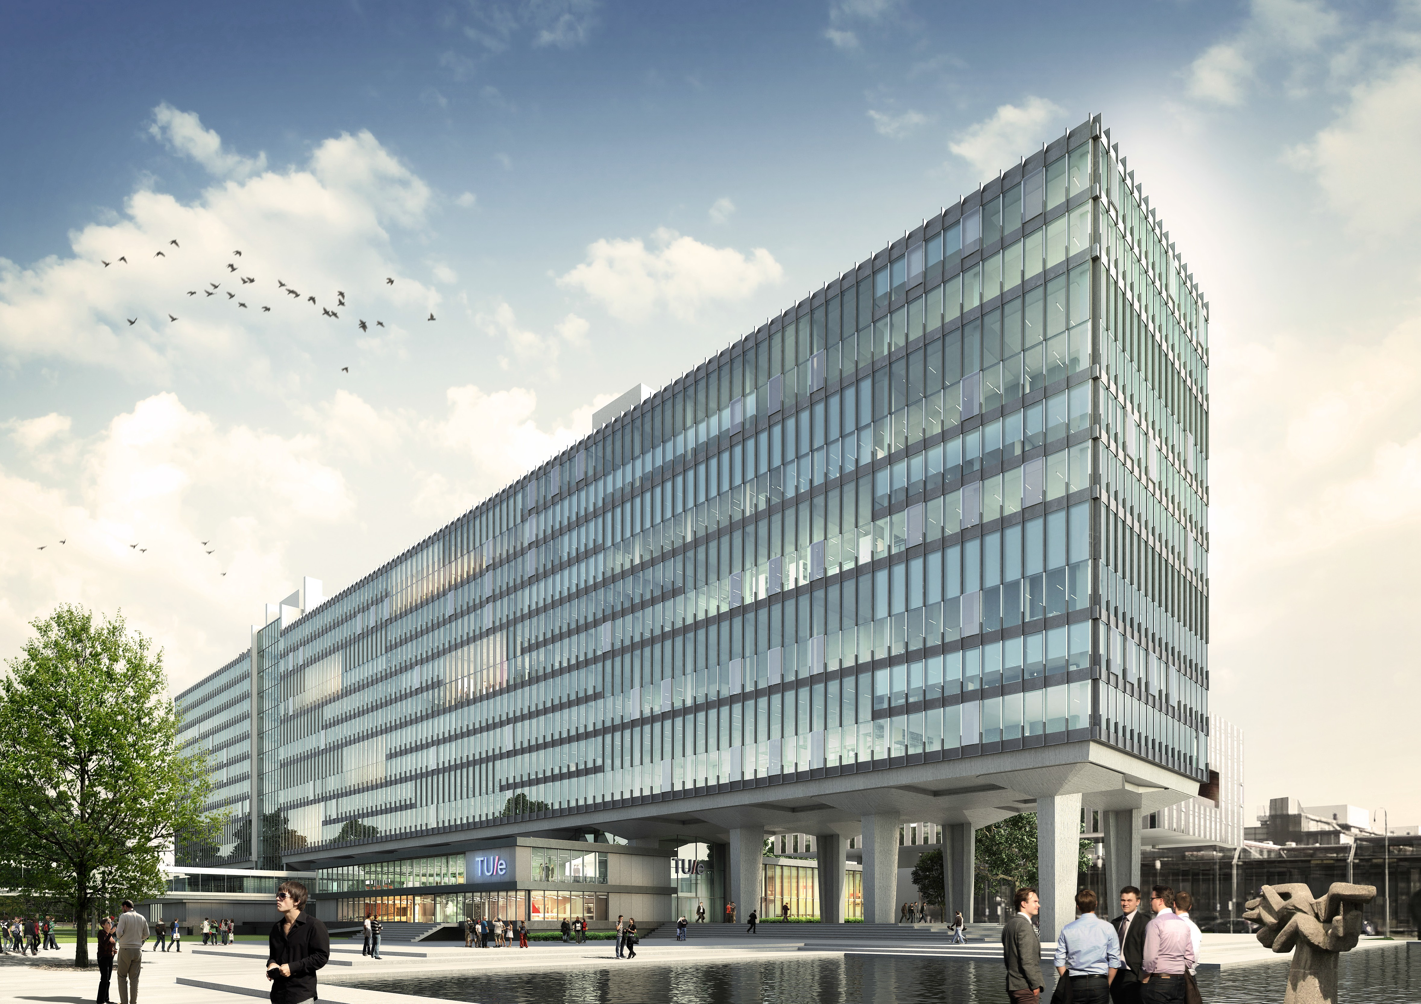
TU/e: Campus 2020
HOOFDGEBOUW TU/E

Slide 7
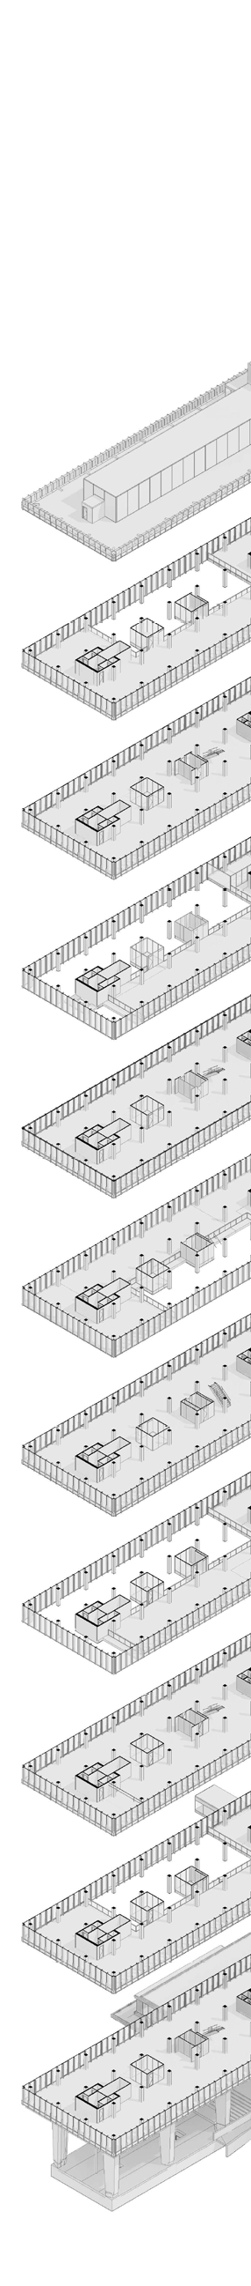
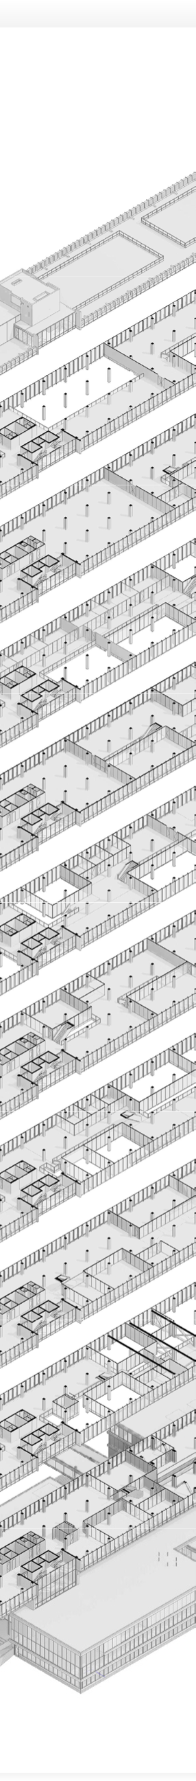
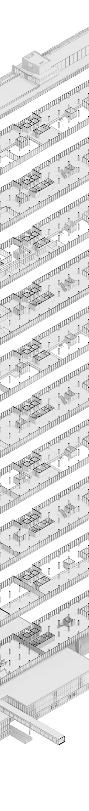
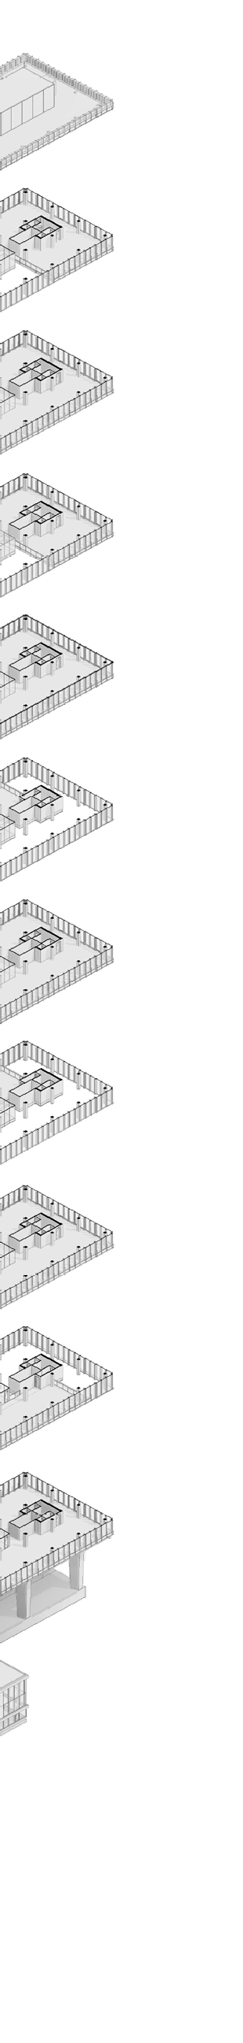
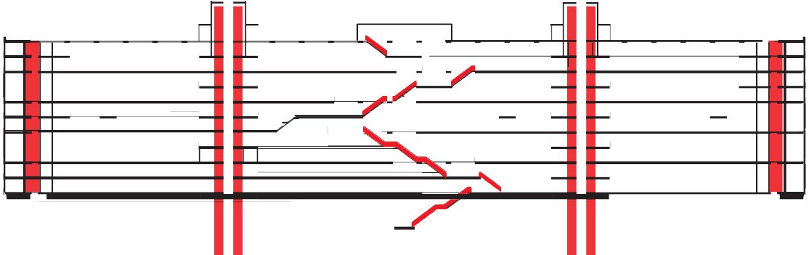
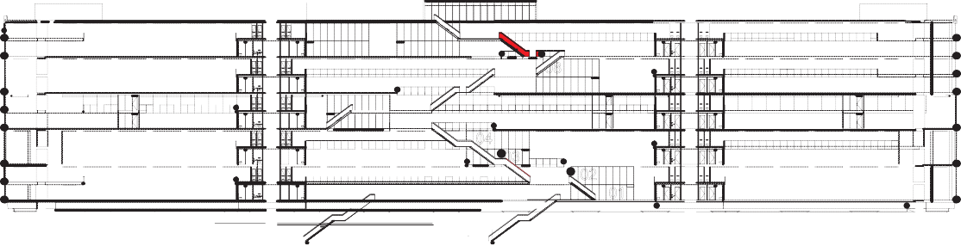
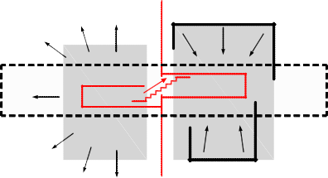
TU/e: Campus 2020
HOOFDGEBOUW
HOOFDGEBOUW TU/E
Doorsnede principe
bestaande vertikale verbindingen nieuwe vertikale verbindingen
Plattegrond principe
Openen van onderbouw, alzijdige transparantie naar omgeving
Verbinden en ontmoeten: Centrale Hal en Rode Trap als hart van het gebouw
Optimaal hergebruik: gevelconstructie en insteekvloeren
Positionering centrale voorzieningen met minimale constructieve aanpassingen
Maximaal flexibel interieur:
ruggengraat en inrichtingsmodules

Slide 8
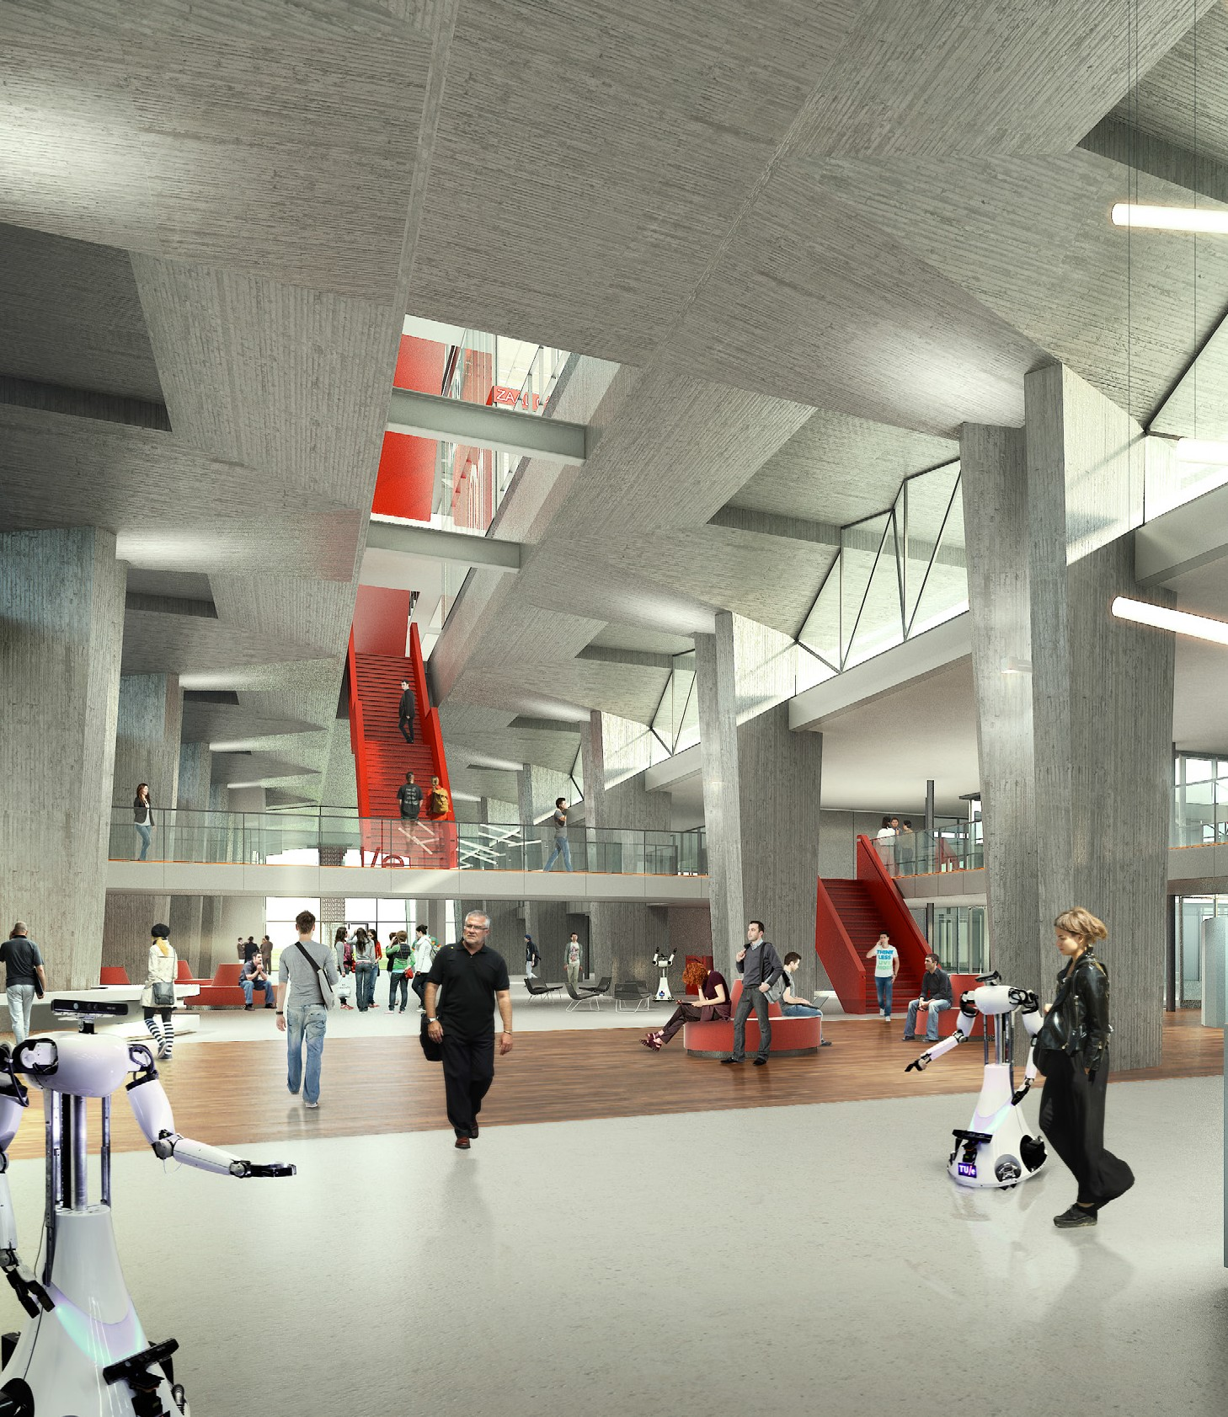
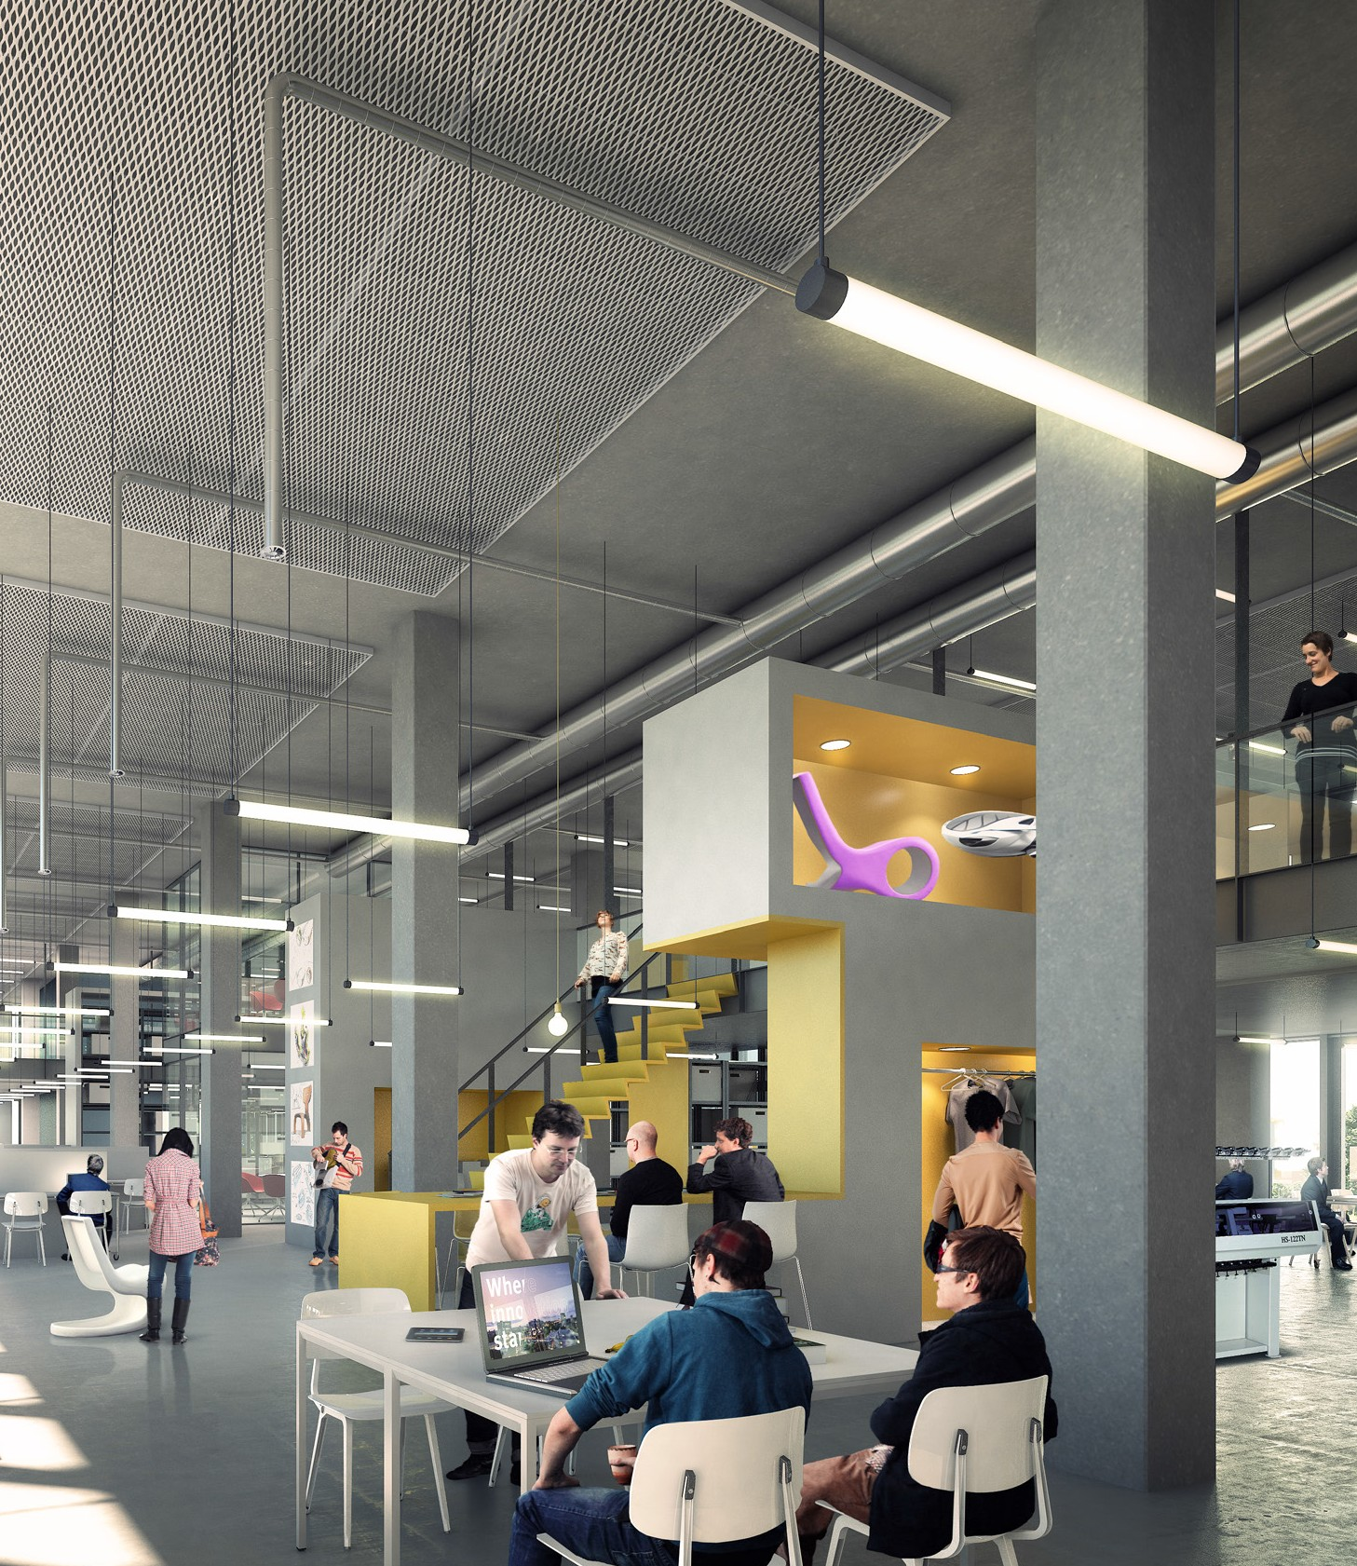
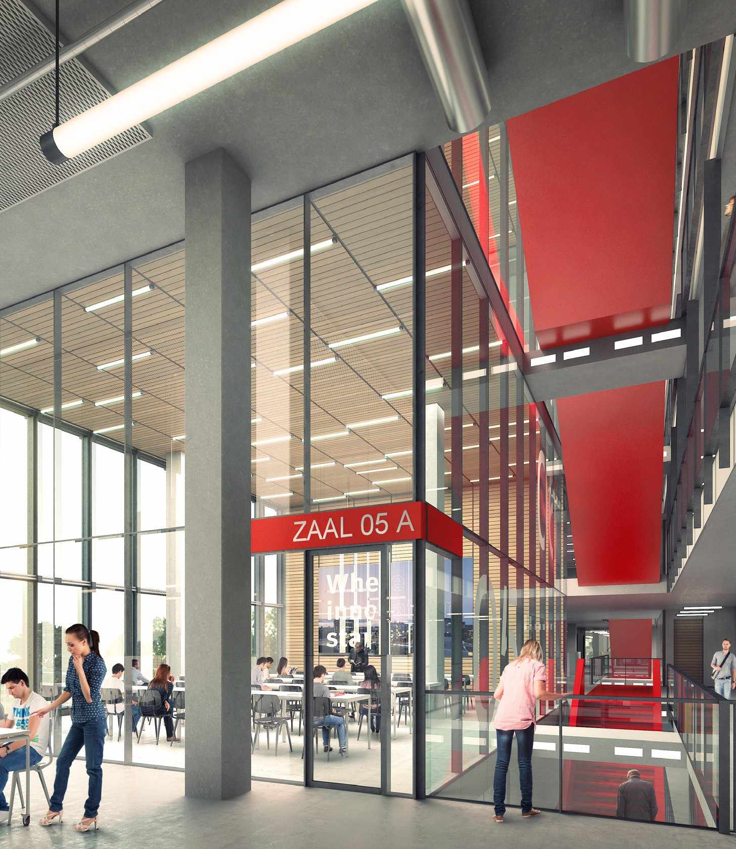
TU/e: Campus 2020
HOOFDGEBOUW
HOOFDGEBOUW TU/E

Slide 9
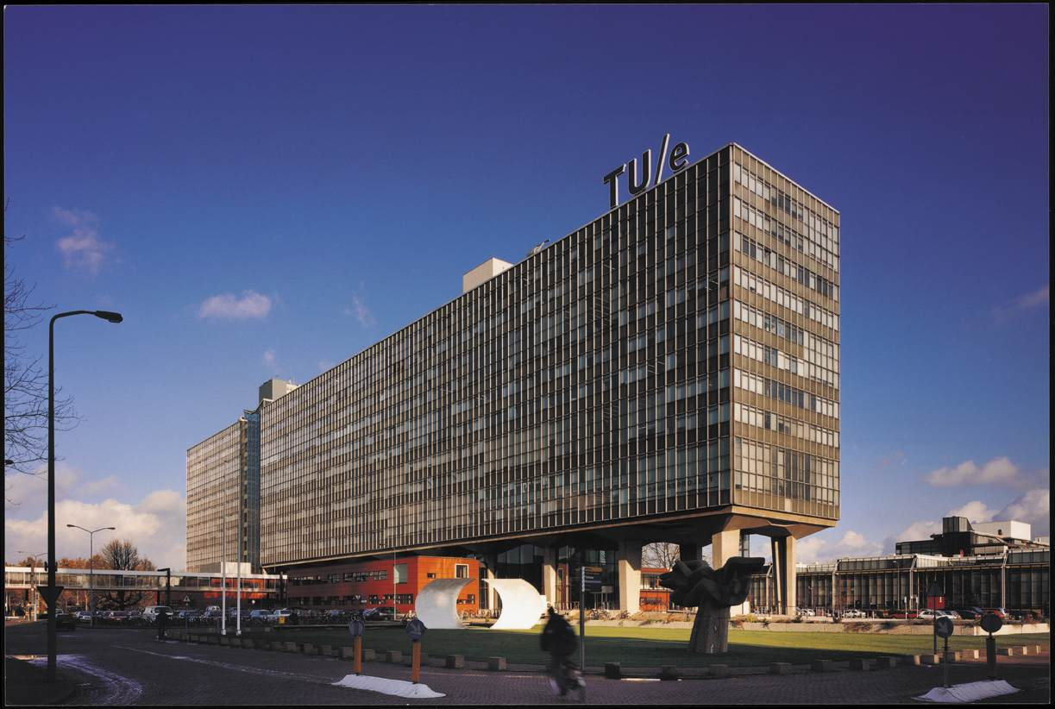
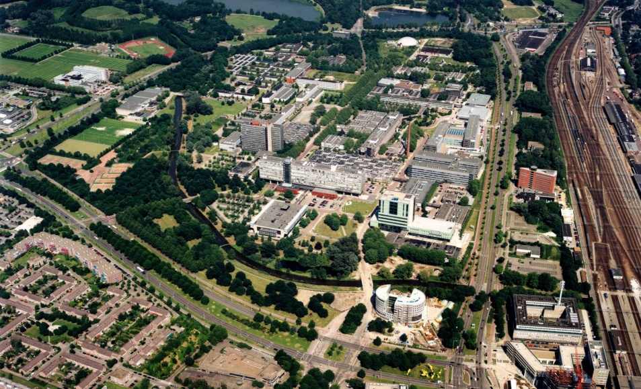
Technische Universiteit Eindhoven
Opgericht in 1956
8.200 studenten
240 hoogleraren
3.200 medewerkers
15 major programma’s
28 master programma’s

Slide 10
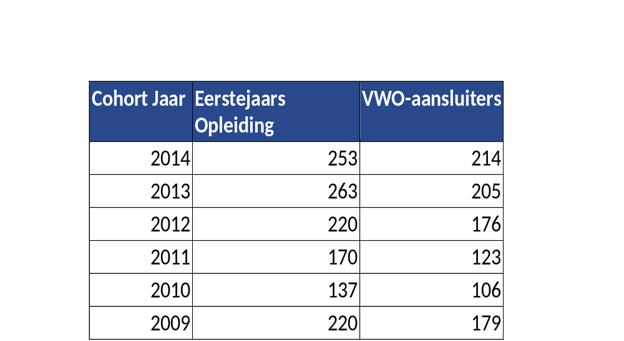
Instroom Technische Bedrijfskunde
Instroom TU/e in 2014: ongeveer 1800 studenten
Waarvan Technische Bedrijfskunde:

Slide 11


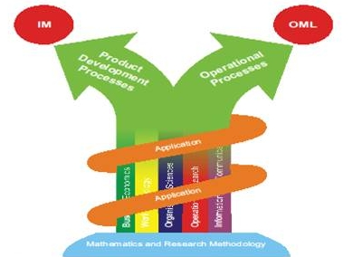


Introduction: Bachelor Foundations and Master Specializations of Industrial Engineering
Industrial Engineering
at TU/e
IE&IS
PAGE 11
Notes:
11

Slide 12
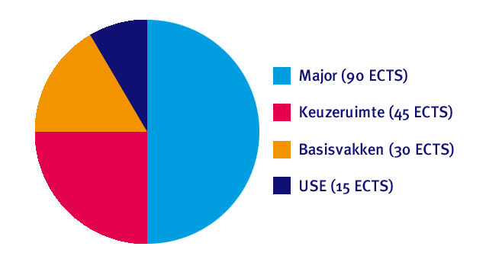
TU/e Bachelor College
User, Society & Enterprise

Slide 13
Keuzevakken en -pakketten
Ruimte voor 12 vakken:
  2 coherente keuzepakketten (max 6 vakken):
    Van alle faculteiten
    Verdieping of verbreding: economie, logistiek,
    arbeids- en organisatiepsychologie
    Momenteel c.a. 250 vakken
  1 USE-leerlijn van 3 vakken

Slide 14




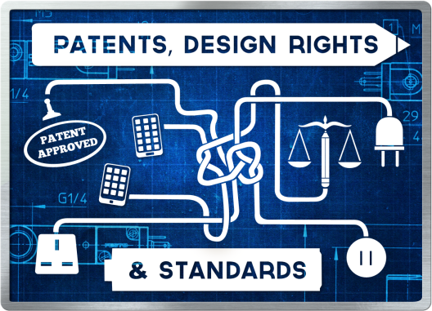





USE Leerlijnen
Notes:
Use Leerlijnen: keuze in het tweede jaar, 1 van deze USE-lijnen, 3 vakken

Slide 15

Coaching
Focus op keuzecoaching
Door een docent
Naast studentmentor en studieadviseur
Taak van docentcoach:
4-5 maal per jaar gesprek met (een groep) studenten
Over keuzevakken, richting van studie en het
ingenieursprofiel

Slide 16
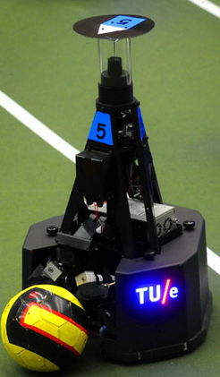
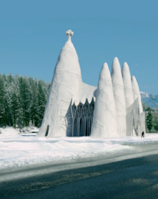
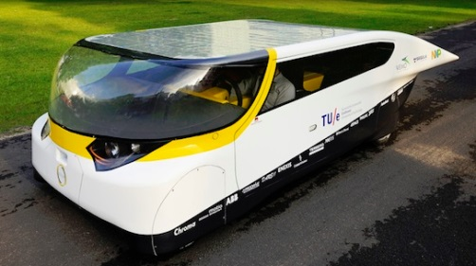
Actieve studenten
Vanuit het Bachelor College
    ‘Inschrijven = meedoen = slagen’
Vanuit de opleiding:
  elk vak heeft twee tussentoetsen en een eindtoets (in jaar 1)
  Actieve studiebegeleiding
Vanuit de student:
  Honours programma
  Projecten: Stella, Storm
  Studievereniging Industria
  Eigen bedrijf
  Etc!

Slide 17
Programma BSc TBdk
Kwartiel 1 | Kwartiel 2 | Kwartiel 3 | Kwartiel 4
Jaar 1
Calculus | Physics | Modeling | USE
Deterministic Operations Mgt | Organization, Strategy and Innovation | Mathematics 1 | Statistics
Work & Organiz. Psychology 1 | Keuzeruimte | Business Modeling | Keuzeruimte
Jaar 2
Design | Research Methods | Buying Behavior & Innovation | Design of Business Information Systems
Intro to Financial and Management Accounting | Mathematics 2 | Stochastic Operations Management | Product Innovation Processes
Keuzeruimte / Use | Keuzeruimte / Use | Keuzeruimte / Use | Keuzeruimte / Use
Jaar 3
Business Information Systems Mgt | Work & Organiz. Psychology 2 | Bachelor Endproject | Bachelor Endproject
Supply Chain Mgt | Reliability | Keuzeruimte | Keuzeruimte
Keuzeruimte / Use | Keuzeruimte / Use | Keuzeruimte / Use | Keuzeruimte / Use
Notes:
Overzicht bachelorprogramma Technische Bedrijfskunde
Hier zie je het programma van de gehele bacheloropleiding, verdeeld dus over 3 jaren. Elk jaar bestaat uit 4 kwartielen. In elk kwartiel heb je 3 vakken.

Slide 18
Aansluitende masteropleidingen
Directe doorstroom mogelijk naar:
Innovation Management
Operations Management & Logistics
Business Information Systems
Construction Management & Engineering
Doorstroom naar andere masters binnen TU/e (afhankelijk van de vakken in keuzeruimte)
Doorstroom mogelijk naar andere masters buiten TU/e
Notes:
Met de major Technische Bedrijfskunde kun je direct doorstromen naar de TU/e-masteropleidingen Innovation Management en Operations Management & Logistics. Afhankelijk van de vakken die je volgt in jouw keuzeruimte kun je doorstromen naar andere TU/e-masteropleidingen en masteropleidingen buiten de TU/e.

Slide 19
Domain MSc OML
Operations Management & Logistics deals with the modeling, analysis and management of operational business processes, i.e. processes that are essential in delivering a product or service to a customer
  Manufacturing
    Production control and production management
  Services
    Workflow modeling and workflow management
    Health care operations management
  Logistics
    Supply chain management, inventory management
    Transportation optimization

Slide 20
OML: different research interests
incentives and motivation
impact of stress and well-being on performance
business process modeling
ICT architectures
software engineering
production planning
inventory control & supply chain planning
operational finance
quality and reliability engineering
…

Slide 21
MSc OML Program Structure
Courses fall into four categories:
  Core courses (10 ects)
  Track core courses (20 ects)
  Specialization electives (min 15 ects)
  Free electives (max 40 ects)
    Can also take homologation courses (max 15 ects)
MSc Thesis:
  Literature review (5 ects)
  Research proposal + Thesis work: (30 ects)
  More than 90% of the projects are conducted
  in industry

Slide 22
MSc OML Tracks
1. Healthcare
2. Capital Goods
3. Consumer Goods
4. Service Operations
5. Transportation
(+ a Free Track for honors students)

Slide 23
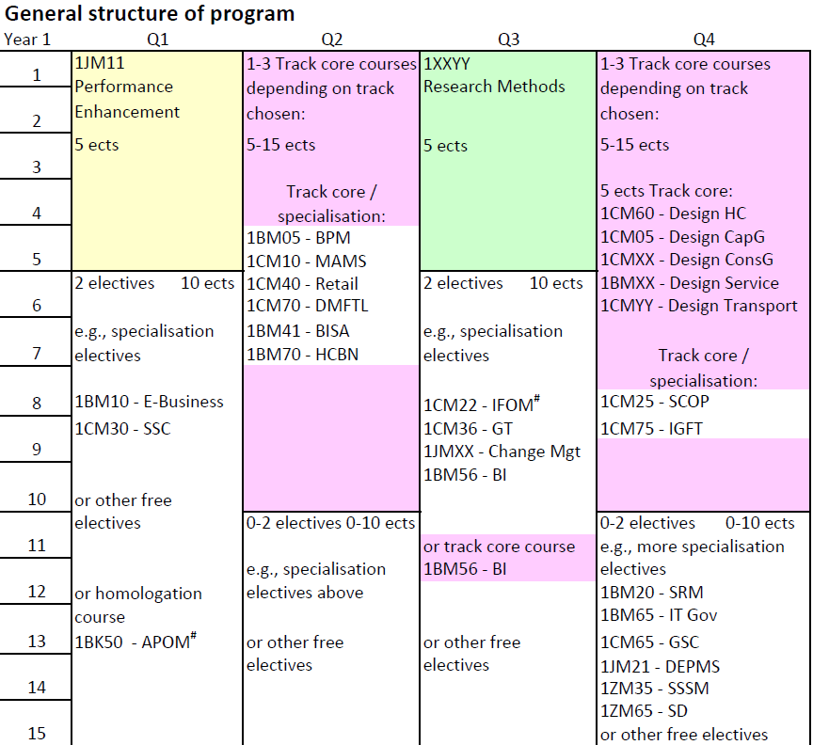

Slide 24
Key strengths OML
Excellent set of professors who are recognized worldwide – both in academia and industry – as thought leaders in their field
Extremely close relationship between mentor and student over an extended period of time
Both in-depth theory and industry-applied design ability development
Graduates are in extremely high demand by the best companies
Competitive and cooperative environment

Slide 25
Domain MSc IM
IM at TU/e Eindhoven conveys scientific theories, tools and techniques to manage and improve innovations both
within and across companies.
Students learn how to apply the knowledge that they gain in
carrying out research in innovation management and in in-
dustrial applications. They will also learn ways to analyze the current innovative performance of a company, how to explain it in terms of quality, cost and time, and how to improve this performance by re-engineering innovation processes.
PAGE 25

Slide 26
MSc IM Program Structure
  50/ 50% Core courses and electives, i.e., 30 ECTS each:
    6 x 5 ECTS core courses focus on main Innovation Management content
    and methodology
    Similar share of specialization and free electives, i.e. 30 ECTS
  International Semester, i.e., 15 - 30 ECTS:
    Minimum of 3 x 5 ECTS free elective courses at a foreign university, or
    Maximum of 6 x 5 ECTS free elective courses at TU/e. This may include a literature study for the master thesis
  Master thesis: 30 ECTS
    Master thesis: (30 ECTS, research proposal included)
  Opportunities for a honours track in design or research (20 ECTS)
Year 1
Year 2
PAGE 26

Slide 27
MSc IM Program Structure
IE MSc IM: Core Courses = 30 ECTS
Management of Product Development (5 ECTS)
Marketing and Innovation (5 ECTS)
Human Aspects of Innovation (5 ECTS)
Multivariate Statistics (5 ECTS)
Business Intelligence (5 ECTS)
Design Science Methodology (5 ECTS)
Content
Method
All core courses are taught in Year 1
PAGE 27

Slide 28
Track Specialization Electives IE MSc IM
MSc IM Program Structure
IM Track 1: Business and Product Creation (BPC)
Restricted Specialization Elective: Design Project for Business & Product Creation
Recommended Specialization Electives: Technology entrepreneurship; Open innovation; Entrepreneurial finance;
Entrepreneurial marketing; Selling new products; System dynamics; Software requirements management;
Innovating healthcare through business networks; Managing team dynamics and team performance
IM Track 2: Managing Innovation Processes (MIP)
Restricted Specialization Elective: Design Project for Managing Innovation Processes
Recommended Specialization Electives: Strategy & technology management; System dynamics; Project & process
management; Strategic sourcing & supply management; Service engineering & marketing; Selling new products;
Business process management; Managing team dynamics and team performance; IT governance
IM Track 3: Special / Free Track
Special Track / Free Track, reserved for the honours programs in research and design, and dual-degree options;
All specialization and free electives to be suggested by the personal mentor, and to be approved by the Director GP-IE
*) Restricted Specialization Electives are based on the IM Program Objectives. Recommended specialization electives: 5 out of 9
One of the Recommended Specialization Electives might be exchanged by a Free Elective
Each Specialization Elective = 5 ECTS
Track 1 and 2 are thematic groupings of specialization electives; they are compulsory
PAGE 28

Slide 29
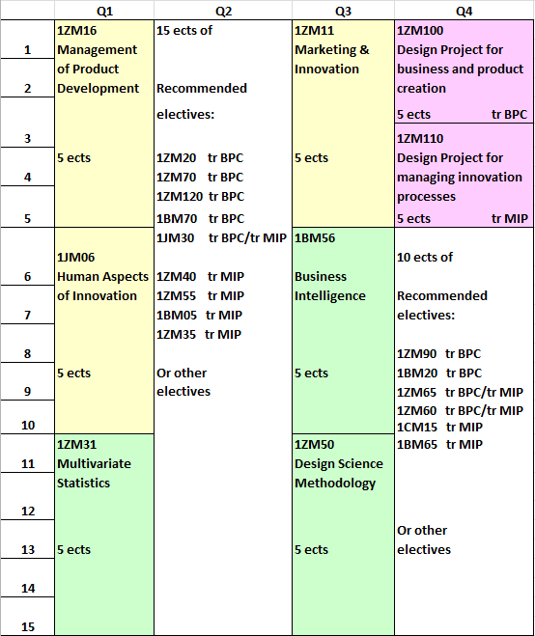
PAGE 29

Slide 30
Main Features IE MSc programs
Recently redesigned! New MSc programs start in Fall 2015.
All classes conducted in English
All courses are quarter courses
In principle, all students will go abroad for an international semester (unless already done at BSc or financial exceptions)
Theory-driven, multi-disciplinary, and project-like focus
Learning by reflection and application
Highly interactive lectures, assignments and group work
Topics related to research of the school’s professors
Apply knowledge in academia, industry and consultancy

Slide 31

MSc Mentor System
At the end of the second quarter (first semester)
Free Market: interviews to match students with mentors
Role of the Mentor
  Advise on / approval of electives
  Advise on planning international
  semester (e.g., school, courses)
  Assistance with selection and preparation of
  thesis (topic, company)
  Topic of thesis needs to match with research
  interests of the mentor
  Supervision of thesis project

Slide 32
MSc Course characteristics
Content related to current research by finding additional literature and other academic sources
Students conduct design projects, based on actual business processes, and relate this to the scientific literature
Content placed in its original context contains various perspectives, including scientific controversies
Student reporting is not limited to the actual design assignment, but always reflects on the relative contribution of the various disciplines, the societal context and impact, and the feasibility of implementation related to the specific circumstances, including regional and business cultures.
Notes:
Content related to current research
Content positioned within the research context in which it has originated
Students conduct design projects and relate this to the scientific literature
Contents contain various perspectives, including scientific controversies, and critically analyse these controversies
Design projects within courses are based on actual business processes
Students are required to independently find additional literature and other academic sources
Student reporting is not limited to the actual design assignment, but always reflects on the relative contribution of the various disciplines, the societal context and impact, and the feasibility of implementation, related to the specific circumstances, including regional and business cultures.

Slide 33
MSc Honours Tracks
An honours track is a special program of 30 ECTS integrated
with the MSc Program, for selected excellent and
ambitious students
The goal is to develop advanced capabilities for:
  Design in Industrial Engineering
  Research in Industrial Engineering
To facilitate better entrance into:
  The PDEng Program for designers
  The PhD Program for researchers
PAGE 33

Slide 34


TU/e TBdk: hoge kwaliteit
De TU/e heeft de beste opleiding Technische Bedrijfskunde
(Keuzegids Universiteiten 2015 en Elsevier 2014)
Ook OML en IM hoogste rankings
De TU/e is de beste (Technische) Universiteit in Nederland
(Keuzegids Universiteiten, 2015 en Elsevier, 2014)
Notes:
L

